Slide 1



Communicating Value Across Audiences
Advancing an Aspirational Vision for Higher Education
Thursday, July 23, 2026

Slide 2


State Attainment Collaborative Webinars
February: Value-Centered Attainment Goals
March: Identifying and Supporting Focus Populations
April: Data Workshop
June: Stakeholder Engagement
July: Strategic Communications

Slide 3




Why Goal 2040?
Shifts in the nation’s postsecondary and workforce ecosystem…
Less confidence in postsecondary education, with confidence in postsecondary education 15 percentage points below where it was in 2015 despite recent increases from 2024 lows.
Increased pressure on postsecondary education to demonstrate outcomes, as evidenced by state and federal policy shifts.
Uncertain economic futures, amplified by the proliferation of Artificial Intelligence

Slide 4



Why Goal 2040?
….create a need for a new North Star that:
Rebuilds confidence in the ability of higher education to provide real value to students, communities, and the nation
Guides strategic decision-making to strengthen higher education and promote alignment across education and work
Supports skill development that can meet rapidly evolving workforce needs

Slide 5

The Role of Strategic Communications
A value-centered attainment goal is only effective if it is:
Relevant, reflecting real challenges and needs of various stakeholders
Understood, communicated clearly to a range of audiences
Aspirational, creating a vision for improved outcomes for learners and the state

Slide 6

Agenda
Welcome
Communicating Vision through an Aspirational Lens
Storytelling Framework
Reaching Priority Audiences
Closing

Slide 7

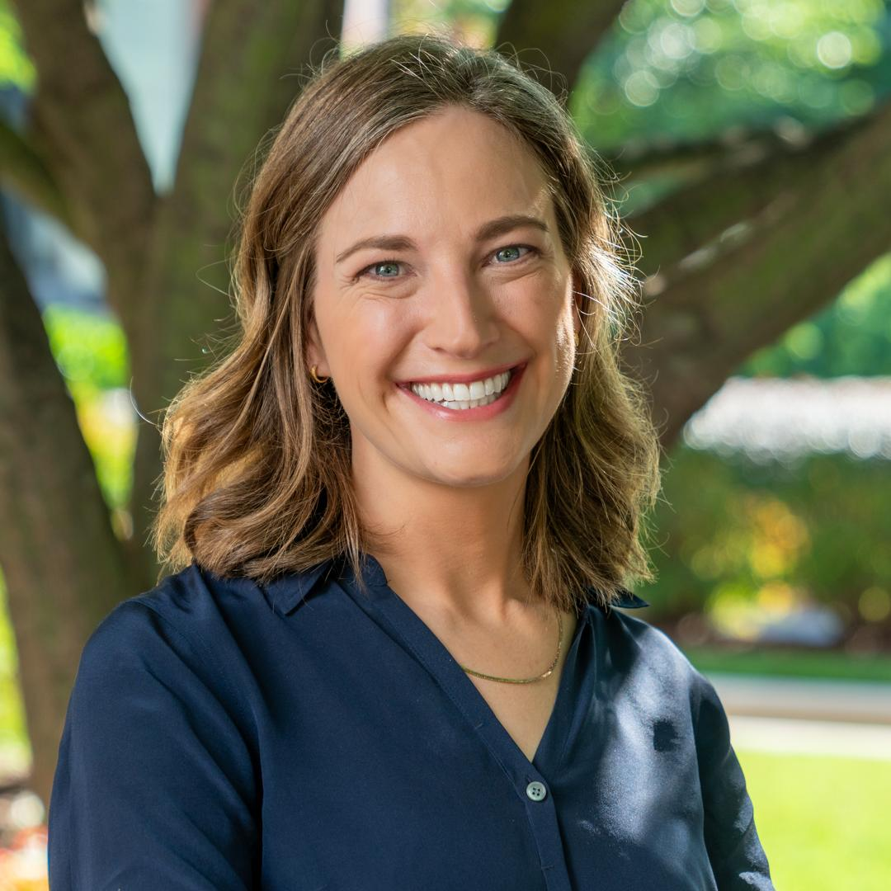

Communicating Value Across Audiences
Veronica Selzler
Managing Director, Strategy & Team Development
Hattaway Communications

Slide 8
Objectives
What is value? Clearly communicating your vision
Why now? Inspiring support by making credentials of value relevant
How can you reach different audiences? Adapting communications to reach institutions, workforce leaders, policymakers and beyond

Slide 9
What is value?
Clearly communicating your vision

Slide 10

Aspirational Communication
Aspirational: How does higher education contribute to the lives we want to live and the communities we want to live in?
Social: Who feels like they benefit from higher education? Who might feel excluded?
Emotional: How does pursuing a degree or credential make people feel?
Functional: How does higher education help people and communities?

Slide 11
Communicating an Aspirational Vision
Aspirational: How does our vision help people achieve their highest hopes for themselves and their community?
Social: How does our vision help more people see themselves with a degree or credential?
Emotional: How does our vision inspire people and give them confidence?
Functional: How does our vision make people’s lives better and make communities stronger?

Slide 12
An Aspirational Vision:
What Matters To Our Audiences
Positive outcomes for individuals and communities
Increasing attainment is a means to an end
People’s lives are improved

Slide 13
An Aspirational Vision:
What Matters To Our Audiences
Positive outcomes for individuals and communities
Increasing attainment is a means to an end
People’s lives are improved
Not just about process
  X By 2040, higher ed programs will align with workforce demand.
Doesn’t position attainment as an end in itself
  X By 2040, 60% of adults will have a college degree.
Doesn’t only say how institutions are different
  X By 2040, 95% of degree-offering institutions will provide credentials of value.

Slide 14
An Aspirational Vision:
What Matters To Our Audiences
Positive outcomes for individuals and communities
Increasing attainment is a means to an end
People’s lives are improved
EXAMPLE: Lumina Foundation
Attainment Goal: By 2040, 75% of adults in the U.S. labor force will have college degrees or other credentials of value leading to economic prosperity.
Defining Value: Economic prosperity means people with college degrees, certificates, or industry certifications earning at least 15 percent more than the national average for adults with only high school diplomas.

Slide 15
Why now?
Inspiring support by making credentials of value relevant

Slide 16



 |  | ICON
Opportunity That’s Real | Security Amid Uncertainty | Communities That Work
Removing barriers can make opportunity real for all students. | Going to college helps people build confident futures in an unpredictable world. | More people finishing college contributes to communities that work for everyone.

Slide 17

Creating Audience-first Stories of Value
YOUR
AUDIENCE
SHARED ASPIRATIONS
BARRIERS
OR NEEDS
CREDENTIALS
OF VALUE
WAYS WE CAN ALL CONTRIBUTE

Slide 18
Creating Audience-first Stories of Value
State policymakers
Want communities to work well
Constituents
aren’t stable
Credentials of value give people security amid uncertainty
Institutions, policymakers, and the public all play a role

Slide 19
Creating Audience-first Stories of Value
Business
owners
Want skilled employees and healthy communities
It’s hard to hire and keep great staff
Credentials of value prepare people to excel in all kinds of careers
Institutions and business owners can partner to create quality programs

Slide 20
Creating Audience-first Stories of Value
Leaders at institutions for higher ed
Want more students to complete their degrees
Fears about cost and lost time mean some students leave
Credentials of value give students confidence that the tradeoffs
are worth it
Institutions have the support of state and local leaders

Slide 21
Frame Your Own: Audience-first Stories of Value
WHO IS YOUR
AUDIENCE?
WHAT ASPIRATIONS DO YOU SHARE WITH THEM?
WHAT BARRIERS
DO THEY FACE OR NEEDS DO THEY HAVE?
HOW DO CREDENTIALS
OF VALUE HELP?
HOW CAN BOTH YOU AND YOUR AUDIENCE CONTRIBUTE?

Slide 22
How can you reach different audiences?
Adapting communications to reach institutions, workforce leaders, policymakers and beyond

Slide 23
Adapting Communications to Reach Audiences
Strategy What do you need your audience to know, feel, and do? | Framing How can you help them achieve their goals? | Tools What language, stories, and data will matter to them?

Slide 24
Policymakers
Strategy What do you need your audience to know, feel, and do? | Framing How can you help them achieve their goals? | Tools What language, stories, and data will matter to them?
Lieutenant Governor Sanchez serves on the governing board. We need her to see the cross-sector relevance of the goal and embed it into the state’s economic development plan. | Lt. Gov. Sanchez is competing with neighboring states to draw more people and dollars. The higher ed goal gives her a clear framework for how that sector can contribute to statewide objectives. | Language about state competitiveness and return on higher ed investment Stories from constituents in priority districts Data about tax contribution per quality credential; numbers of unfilled jobs that require training

Slide 25
Workforce Leaders
Strategy What do you need your audience to know, feel, and do? | Framing How can you help them achieve their goals? | Tools What language, stories, and data will matter to them?
Tech CEO Martin is a major employer in the state. We need him to help us define value, and serve as a bipartisan advocate for why credentials of value matter. | Martin wants to be able to hire and retain the best and brightest, and wants his company to be seen as a responsible employer. As a champion of credentials of value, he can help shape the way institutions prepare his future employees. | Language that reflects business priorities Stories about how employers and institutions are working together to inform credentials Data that shows how credentials of value impact job markets

Slide 26
Leaders at Institutions for Higher Education
Strategy What do you need your audience to know, feel, and do? | Framing How can you help them achieve their goals? | Tools What language, stories, and data will matter to them?
We want State University President Jones to know about the attainment goal, share ideas for how they are making it happen, and champion those ideas to other university leaders. | President Jones is worried about declining enrollment and confidence in higher ed. By championing the goal, she can bolster people’s confidence that her school is putting students and outcomes first. | Language that aligns with the University’s institutional mission Stories about students and alumni that are better off Data that illustrates long-term impact on students that reflect the University’s demographics

Slide 27
Adapting Communications to Reach Audiences
Strategy What do you need your audience to know, feel, and do? | Framing How can you help them achieve their goals? | Tools What language, stories, and data will matter to them?

Slide 28

Closing
Access all SAC webinar materials through the website
Ongoing meetings with HCM team leads
Stay connected!

