Slide 1



Stakeholder Engagement
State Attainment Collaborative Webinar
Monday, June 8, 2026

Slide 2



Agenda
The Role of Value-Centered Attainment Goals
Participant Survey: Snapshot of State Stakeholder Engagement Status
Facilitated Discussion: Reflecting on Stakeholder Engagement in Maryland and Texas
Group Reflections
Closing

Slide 3

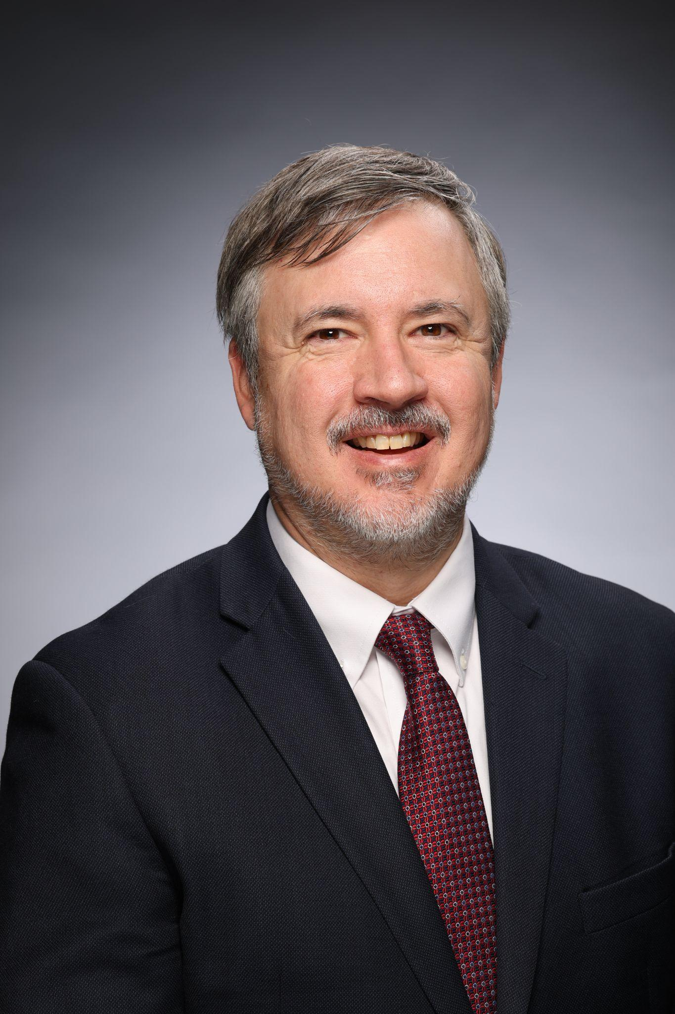
The Role of Stakeholder Engagement in Value-Centered Attainment Goals
Dr. Patrick Crane
State Policy Director, Lumina Foundation

Slide 4






Elements of Strong Attainment Goals
Quantifiable and Measurable, being a number or percent of the population that can be measured over time and is informed by state workforce needs
Value-Centered including a measure of value that at minimum recognizes economic return of postsecondary education
Defined Population, specifying the population, age range, and any focus groups for closing gaps in economic opportunity
Time Bound, having a clear target date to demonstrate commitment
Ambitious and Achievable, being attainable while still requiring a change to the status quo
Formally Set, being adopted through statute, strategic plan, executive order, etc.

Slide 5
Strategic Implementation of Goals
Drive Policy and Practice Change
State, System, and Institution Strategic Plans
Joint Talent Plans
Aligned Policy Agenda to Advance Value and Goal, For Example:
  Funding
  Program Approval and Review
  Grants
  Work-Based Learning
Monitor Progress
Strengthen Data Systems
Annually Report on Goal Progress
Evaluate Strategies to Advance Goals, and Publicly Report Findings
Elevate Best Practices

Slide 6
Building Toward the North Star
North Star: Value-Centered Attainment
1
Health and Human Services
2
Workforce and Economic Development
3
K-12 and Postsecondary Education
4

Slide 7
Stakeholder Engagement is a Powerful and Necessary Tool for State Goals
Stakeholders Can:
Influence the Goal (e.g. institutions of higher education)
Approve the Goal (e.g., Governor’s office)
Champion the Goal (e.g., policy and advocacy organization)
Implement the Goal and Aligned Policies and Practice (e.g., SHEEOs, Workforce Boards)
Be Impacted by the Goal (e.g., students)

Slide 8
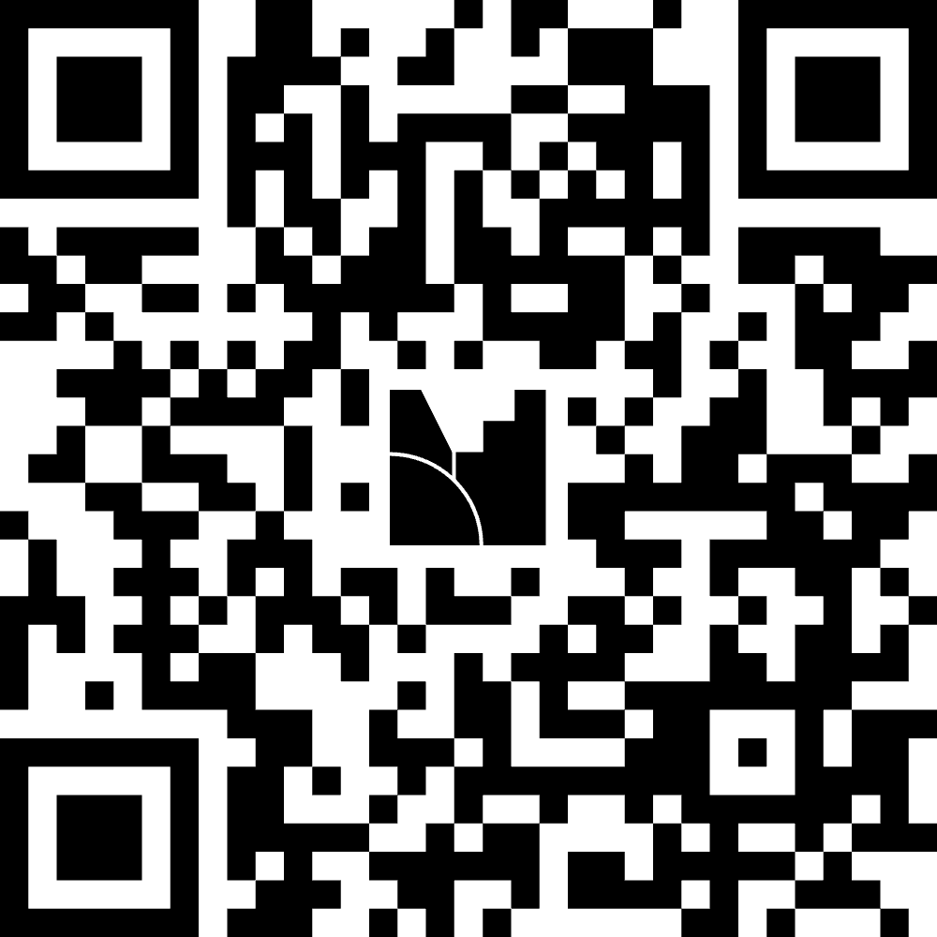
Group Survey: Snapshot of State Engagement Status
https://www.menti.com/alznujxgutxw

Slide 9
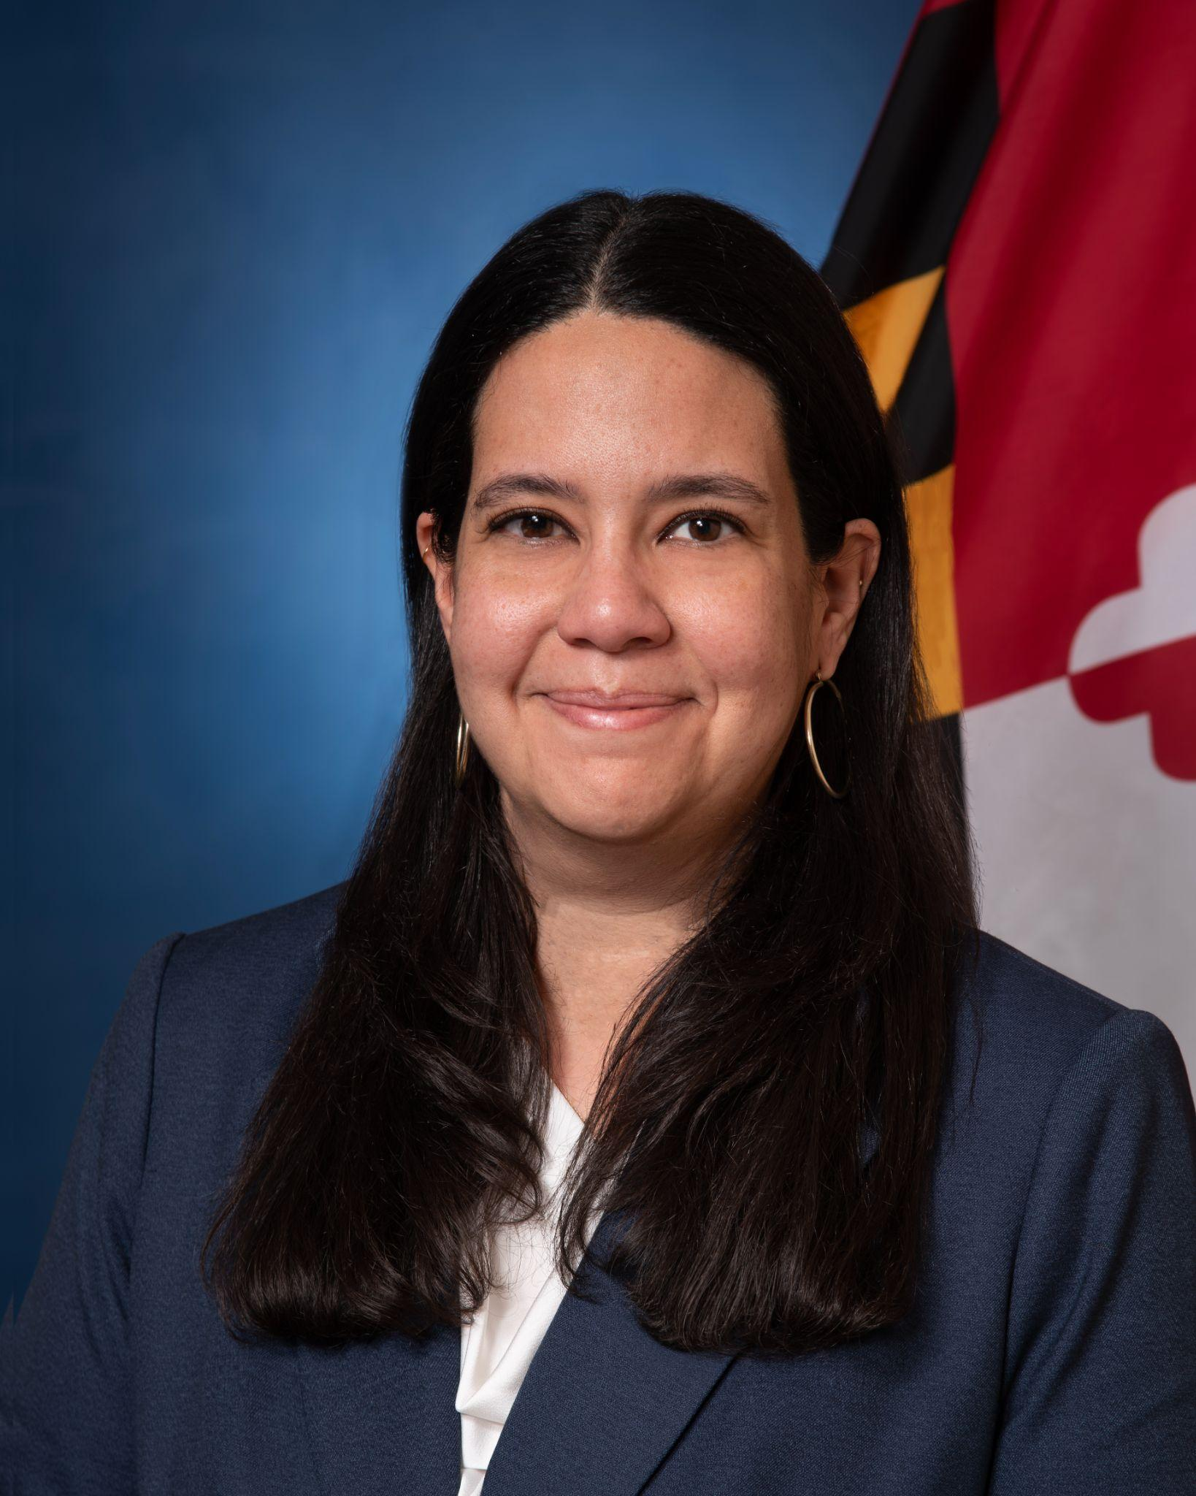
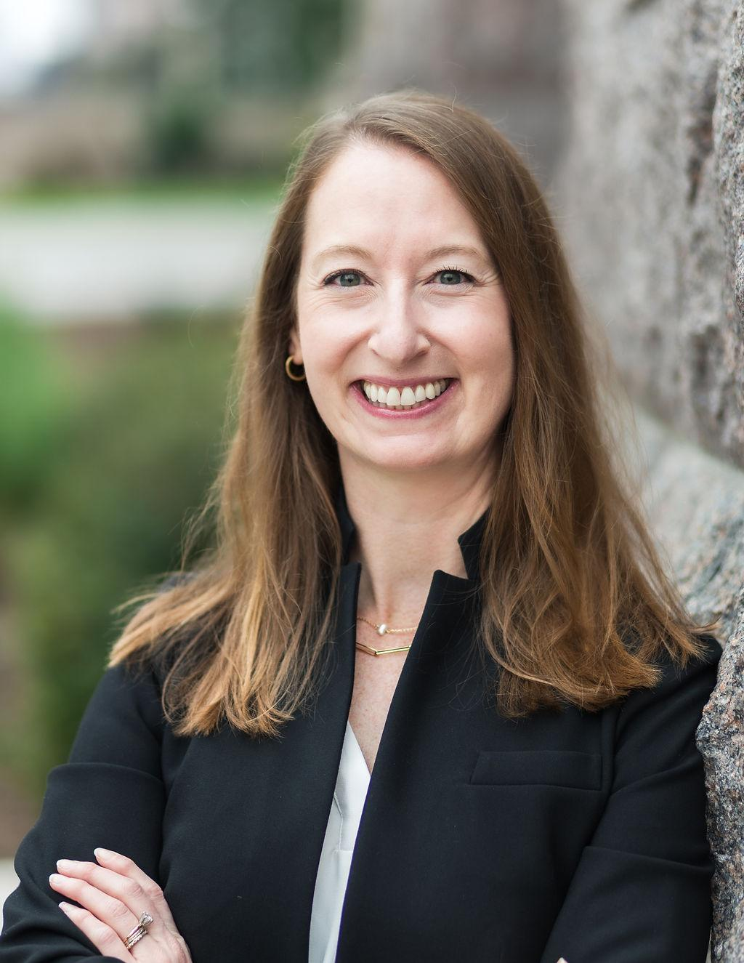
Facilitated Discussion
Reflecting on Stakeholder Engagement in Maryland and Texas
Elena Quiroz-Livanis
Melissa Henderson
Acting Secretary, Maryland Higher Education Commission
Assoc. Commissioner for Strategic Partnerships, Texas Higher Education Coordinating Board; Exec. Director, Texas Higher Education Foundation

Slide 10

Group Reflections
What are two things you can do in the next 1-2 months to move the needle on stakeholder engagement in your state?
https://www.canva.com/design/DAHI6w7IcVc/DLls0SncYkNvwA0v_fkC5g/edit

Slide 11

Closing
Reach out with follow-up questions
Thursday, July 23 at 11:30 ET: Webinar on Strategic Communications

