Slide 1



Value-Centered Attainment Goals
State Attainment Collaborative Webinar
Monday, February 23

Slide 2



Agenda
Goal 2040
Framing State Value-Centered Attainment Goals
Elements of Strong Attainment Goals
Defining Value in Attainment
Discussion
Closing

Slide 3



Goal 2040
Understanding the “Why”
Dr. Courtney Brown
Dr. Chris Mullin
Vice President of Impact and Planning, Lumina Foundation
Strategy Director of Data and Measurement, Lumina Foundation

Slide 4

Goal 2040
A Stronger Nation and a Brighter Future
By 2040, 75 percent of adults in the U.S. labor force will have college degrees or other credentials of value leading to economic prosperity

Slide 5

Path to Goal 2040

Slide 6
Goal 2040
By 2040, 75 percent of adults in the U.S. labor force will have college degrees or other credentials of value leading to economic prosperity

Slide 7
Lumina Goal 2040:
Measuring Economic Prosperity
The percent of Americans in the labor force holding a degree or other credential of value that make at least 15% over a high school diploma alone
Wage/Income (American Community Survey)
15% over a High School Degree Alone
Compared to the National

Slide 8
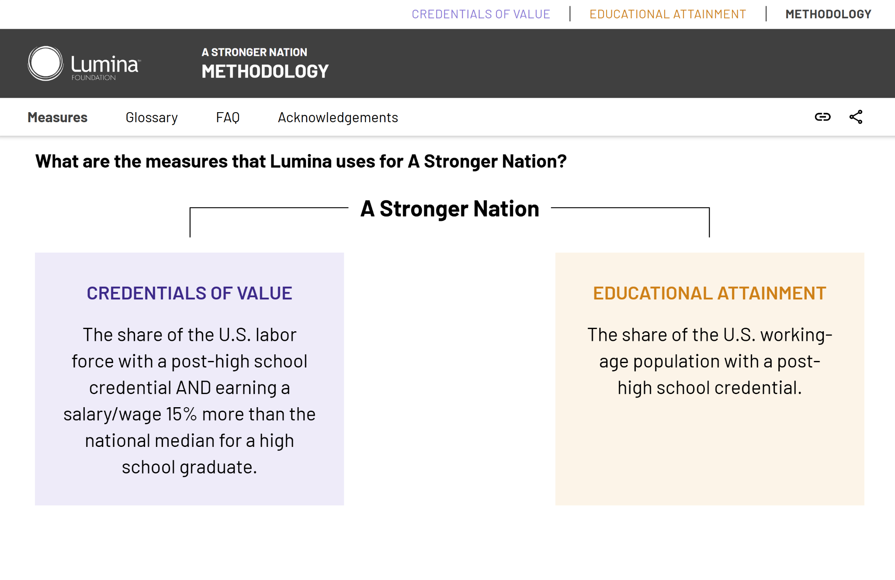
Credentials of Value vs. Educational Attainment

Slide 9
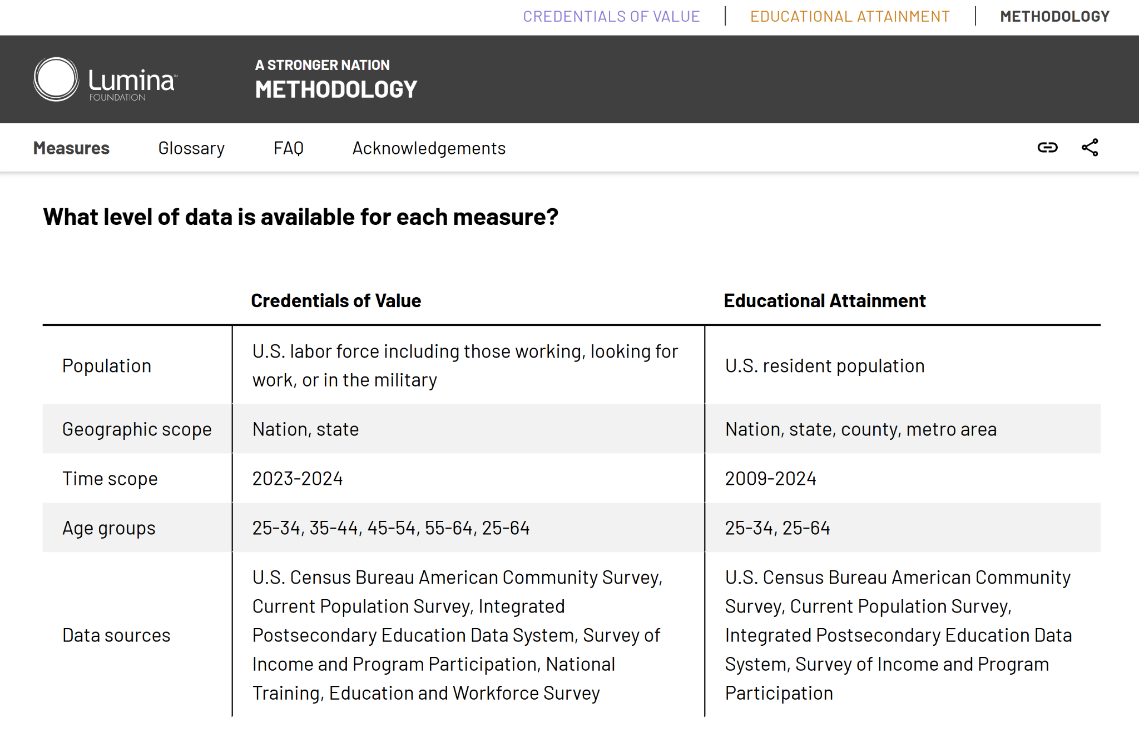
Credentials of Value vs. Educational Attainment

Slide 10
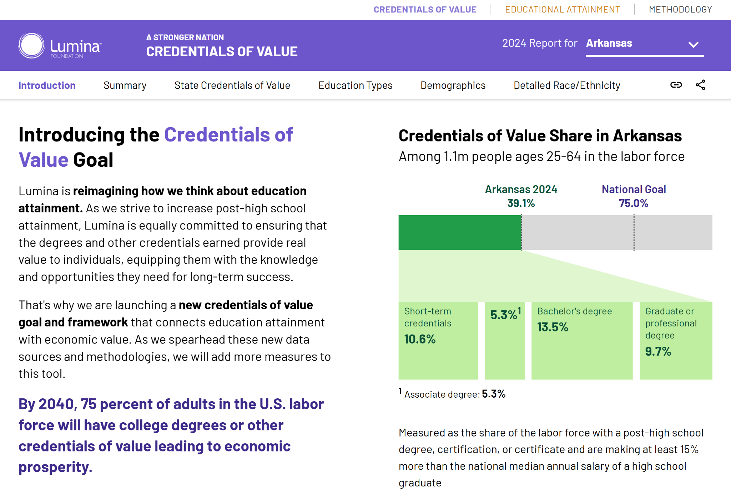
Stronger Nation: Data at the State Level

Slide 11
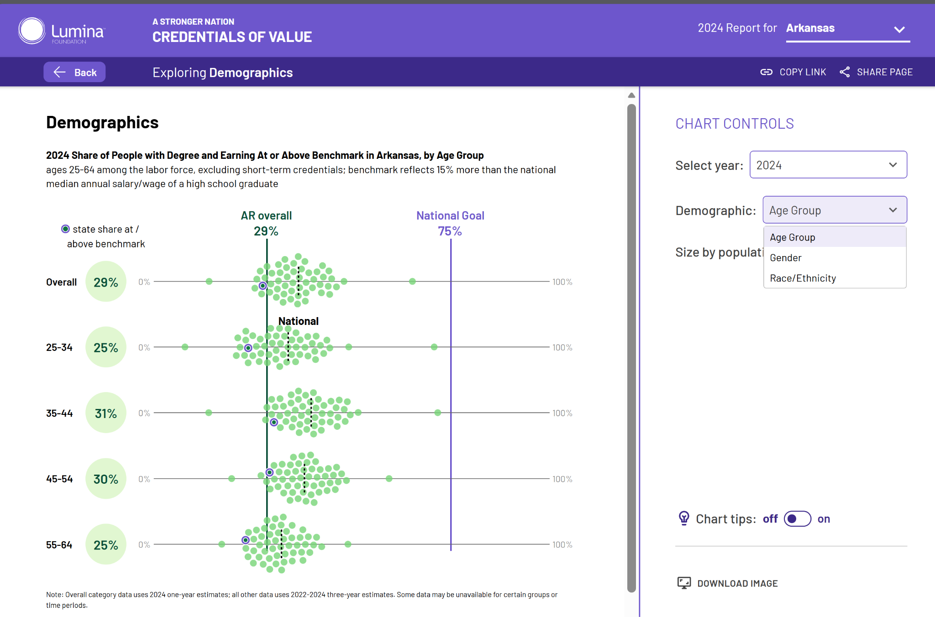
Stronger Nation: Data at the State Level

Slide 12


Framing State Value-Centered Attainment Goals
Martha Snyder
Madeline Price
The North Star
Partner,
HCM Strategists
Director of State Policy and Strategy,
HCM Strategists

Slide 13
North Star: Value-Centered Attainment
Attainment is a mission beyond higher education alone that drives education-workforce alignment, economic development, and quality of life.
Attainment
Attainment refers to the educational levels reached by a specific population. This calculation includes people that received credentials from postsecondary institutions in the state, as well as the number of people that moved into the state (in-migration) with a credential.
Value in attainment goals provides a signal of overall economic and community health
Value-centered attainment goals promote cross-sector alignment and position education as a tool to drive economic development
Lumina Goal 2040: 75% of adults in the labor force will have a postsecondary credential and earn 15% more than the median wage for high school graduates.

Slide 14
Building Toward the North Star
North Star: Value-Centered Attainment
1
Health and Human Services
2
Workforce and Economic Development
3
K-12 and Postsecondary Education
4

Slide 15
The Role of Completion in Advancing Attainment
Completion is a benchmark for higher education to contribute to state value-centered attainment goals.
Completion
Completion refers to students completing postsecondary credentials during a particular time. States can calculate the number of credentials awarded annually or rate of students completing.
Value in completion metrics signals to institutions what programs or outcomes to prioritize, and is a tool for incentives and accountability
Value-centered completion benchmarks articulate a clear intent for institutions to take action to reach attainment goals

Slide 16
Why Completion Alone Isn’t Enough
Focusing on People, Not Only Awards
Reflecting the Cross-Sector Reality of State Ecosystems
Highlighting the Equally Important Role of Access

Slide 17
Framing Value-Centered Attainment Goals
Clear Purpose: Establishing postsecondary education as an engine of economic development.
Stakeholder Engagement: Requires broad, cross-sector participation to advance.
Value-Centered: Not about postsecondary education for education’s sake, but about pathways to opportunity.

Slide 18

Elements of Strong State Attainment Goals
Dr. Patrick Crane
State Policy Director, Lumina Foundation

Slide 19

State Attainment Collaborative Goals
Lumina’s Goal 2040 is a value-centered attainment goal.
The primary objective of the State Attainment Collaborative is for states to explore and establish value-centered, population-based attainment goals.

Slide 20






Elements of Strong Attainment Goals
Quantifiable and Measurable, being a number or percent of the population that can be measured over time and is informed by state workforce needs
Value-Centered including a measure of value that at minimum recognizes economic return of postsecondary education
Defined Population, specifying the population, age range, and any focus groups for closing gaps in economic opportunity
Time Bound, having a clear target date to demonstrate commitment
Ambitious and Achievable, being attainable while still requiring a change to the status quo
Formally Set, being adopted through statute, strategic plan, executive order, etc.

Slide 21

Defining Value in Attainment
Dr. Nate Johnson
Data Sources and Value Measures
Senior Affiliate, HCM Strategists
Founder and Principal, Postsecondary Analytics

Slide 22
Possible Data Sources
American Community Survey
Large annual, statistically representative survey
Choice between 1-year and 5-year estimates
Other economic / demographic surveys: Current Population Survey, Survey of Income and Program Participation, National Training, Education and Workforce Survey
New instruments: Ask graduates/citizens directly about financial and non-financial value
Administrative Data (requires multiple years and other assumptions for attainment estimates)
College Scorecard, PSEO, or state longitudinal data systems

Slide 23
Strategies for Measuring Value
Wage Threshold: Value = Attainment + X Wage
Threshold could be % of high school earnings, MIT Living Wage Calculator, ALICE estimates, or other state-specific estimate
Potential Non-Financial Dimensions of Value (separate or combined with financial dimension)
State-Defined High Priority Fields (e.g. program/occupations driving strategic economic priorities)
Financial Independence (e.g. low rates of food stamp or Medicaid recipiency)
Other Well-Being Indicators (e.g. homeownership)

Slide 24
Elements of Strong Attainment Goals
Quantifiable and Measurable, being a number or percent of the population that can be measured over time and is informed by state workforce needs
Value-Centered including a measure of value that at minimum recognizes economic return of postsecondary education
Defined Population, specifying the population, age range, and any focus groups for closing gaps in economic opportunity
Time Bound, having a clear target date to demonstrate commitment
Ambitious and Achievable, being attainable while still requiring a change to the status quo
Formally Set, being adopted through statute, strategic plan, executive order, etc.

Slide 25
Discussion

Slide 26

Closing
Reach out with follow-up questions
Date TBD: learning opportunity for state-specific attainment data analysis
March 19 at 12:30pm ET: Webinar on Strategic Support of Priority Populations

